Slide 1

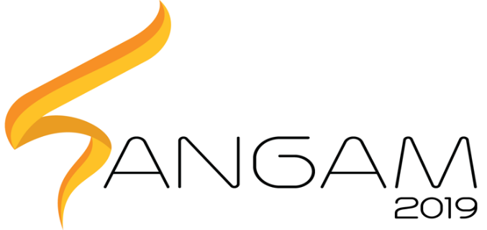
Healthcare and Medical Sciences S.P.E.A.R
PRAGYAN HARDWARE HACKATHON
Soft Pneumatic EMG Assisted Rehabilitation

Slide 2
Aim
The objective of S.P.E.A.R is to provide an affordable soft robotic ankle foot orthosis for rehabilitative purposes, aimed primarily at stroke survivors.

Slide 3
Application
Ease of physiotherapy for those affected with stroke. Physiotherapy is a costly and continuous process, whereas a robotics solution will be a one-time investment. Because of its compliant nature, SPEAR is lighter, smaller and easier to use, contrary to traditional rigid approaches.

Slide 4
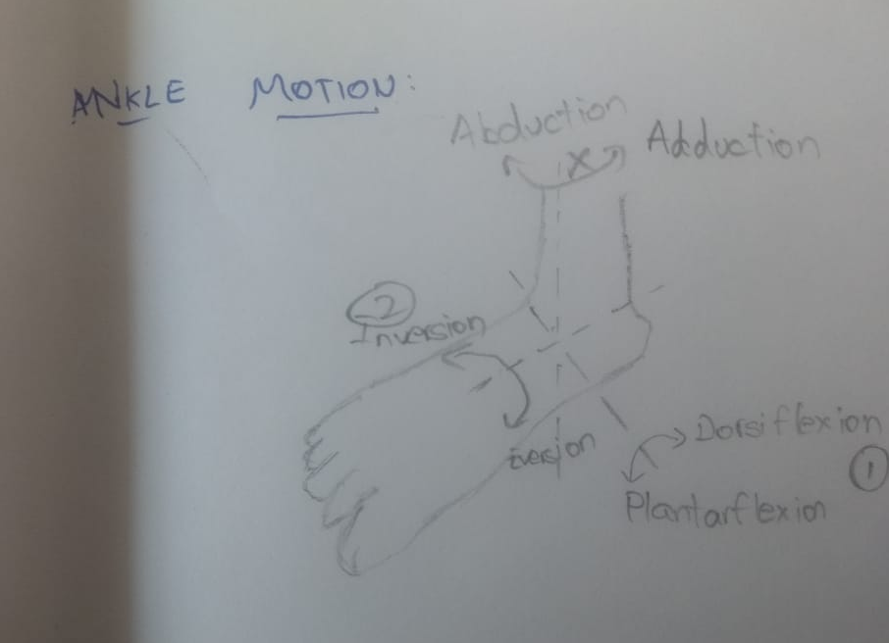
ANKLE MOTION

Slide 5
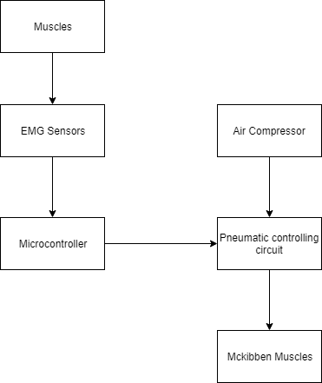
Block Diagram

Slide 6
Progress Report
McKibben Muscles have been fabricated.
The price of a readymade McKibben muscle is minimum Rs.1500
Using off-the shelf components, cost has been reduced to an average Rs.150, depending on Muscle size, diameter
Component | Cost(Rs.)
Bladder(Silicon Rubber) | 40 - 60
Nylon Mesh Sleeve | 40 - 60
Miscellaneous (Connectors, Seals) | 50
Total | 150

Slide 7
Testing Results
Inner Diameter (inch) | Outer Diameter (inch) | Length (cm) | Slack | Contraction (cm) | Percentage Contraction
1/3 | 1/2 | 20 | No | 2.5 | 12.5
1/3 | 1/2 | 20 | Yes | 0.5 | 2.5
1/2 | 5/8 | 30 | No | 3 | 10

Slide 8
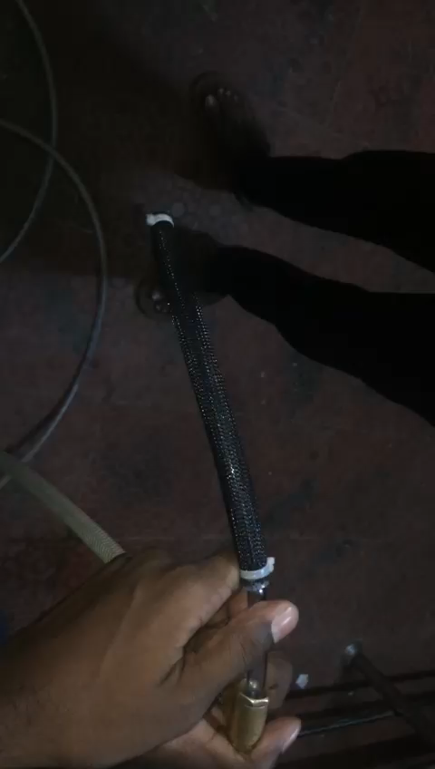
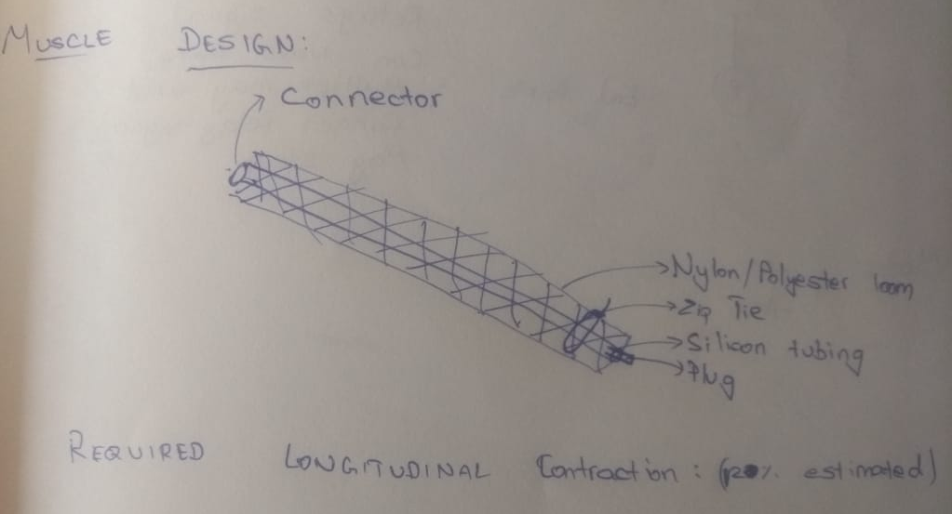
Muscle Test

Slide 9
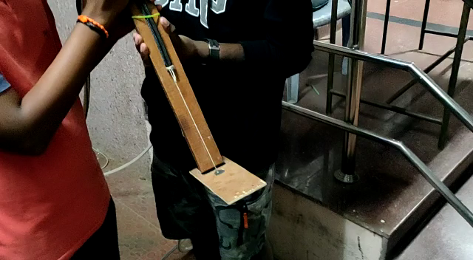
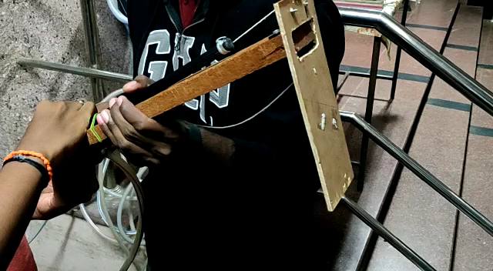
First Prototype
Dorsiflexion
Plantarflexion

Slide 10
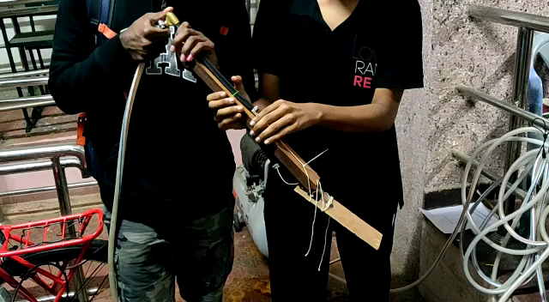
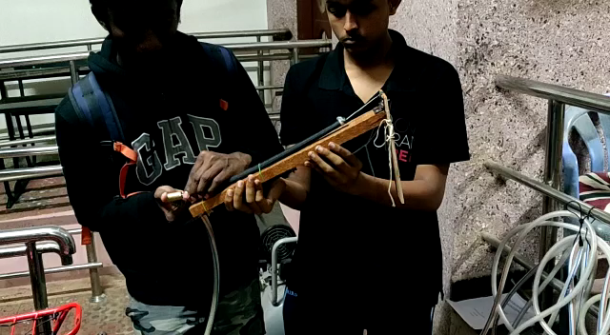
Second Prototype (120˚ range of motion)
Dorsiflexion
Plantarflexion

